Slide 1

RIU SMART AMRAVATI

Slide 2



Slide 3
BENEFITS OF MULTIPURPOSE GRAIN CLEANING & GRADING PLANT
grain lots received from the field are often at high moisture content and contain trash and other inert material, weed GRAIN, deteriorated and damaged GRAIN, off-size GRAIN, etc.
multipurpose grain cleaning & grading plant is necessary in order to dry the grain to safe moisture level; remove or reduce to the extent possible the various undesirable material, weed GRAIN, other crop GRAIN, deteriorated or damaged GRAIN.

Slide 4
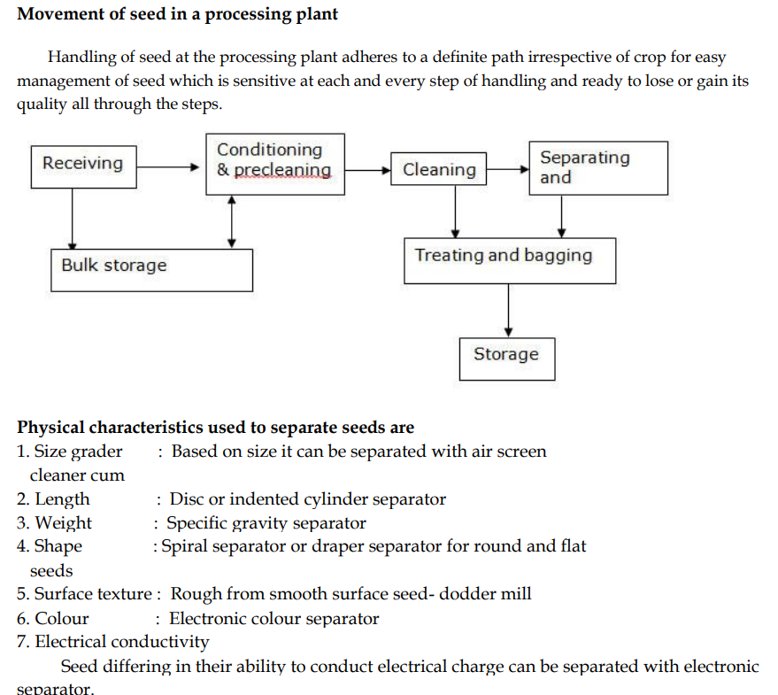

Slide 5
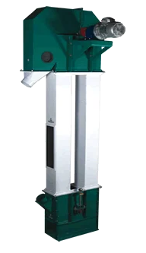
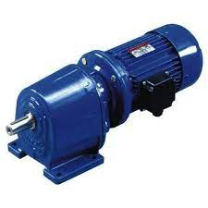
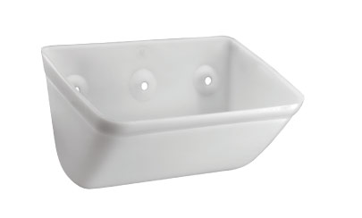
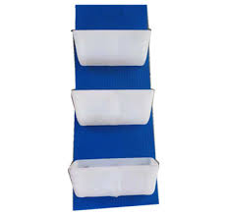
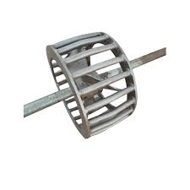
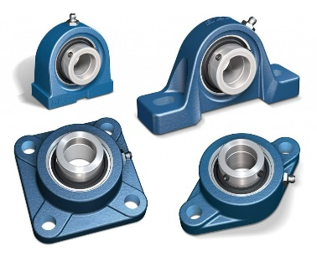
PRODUCT DETAIL :-1.
ELEVATOR MACHINE :-
ELEVATOR MACHINE IS USEFUL FOR SUPPLYING GRAIN & GRAIN TO OTHER MACHINE BY LIFITING
ELEVATOR MACHINE FULL BODY MADE IN M.S SHEET
ELEVATOR TOP , ELEVATOR BOX , ELEVATOR BOTTTOM , ELEVATOR GEAR & MOTOR , ELEVATOR RUBBER BELT , ELEVATOR BUCKET , ELEVATOR BEARING , ELEVATOR PULLEY
GEAR & MOTOR
PVC BUCKET
RUBBER BELT
ELEVATOR PULLEY
ELEVATOR BEARING

Slide 6
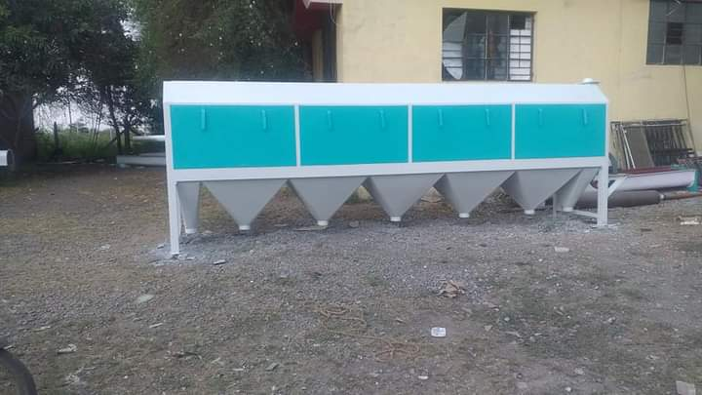
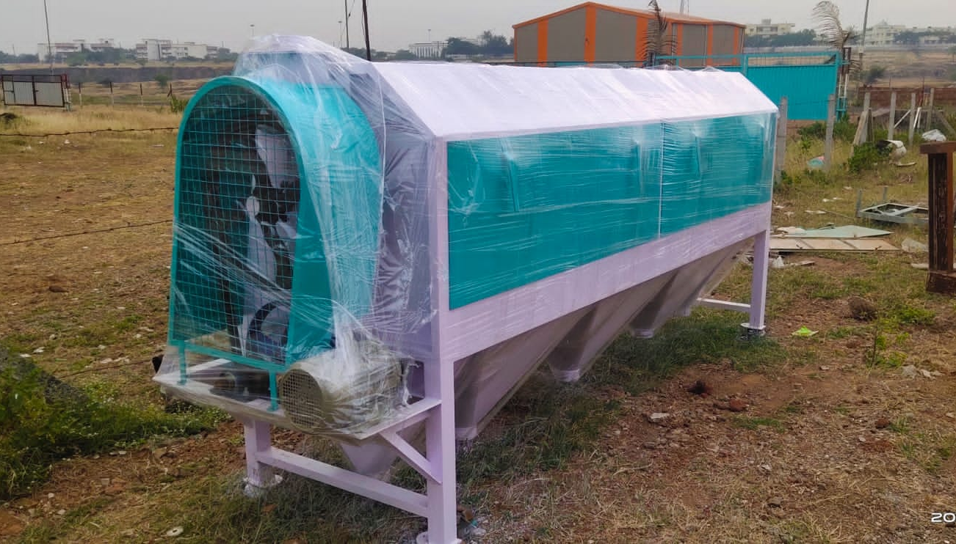
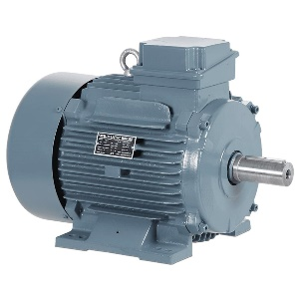
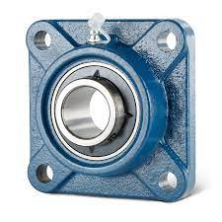
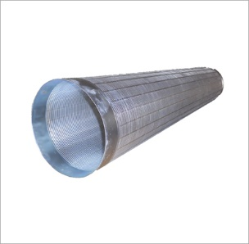
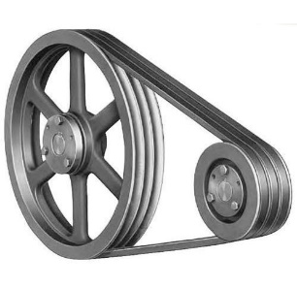
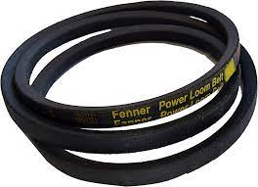
NEW MAHALAXMI ENTERPRISES PRODUCT DETAIL :- 2.
ROUND GRADER MACHINE – 4 SHEET :-
ROUND GRADER MACHINE IS USEFUL FOR GRADING GRAIN IN SIZE
ROUND GRADER MACHINE ARE AVAILABLE IN DIFFERENT PARTS LIKE ROUND GRADER SHEET-1, ROUND GRADER SHEET-2 ROUND GRADER SHEET-3 ROUND GRADER SHEET-4
MOSLTY USED FOR CLEANING MACHINE IS ROUND GRADER SHEET-4
FULL BODY MADE IN M.S SHEET & M.S C-CHANNEL
ROUND GRADER MACHINE PARTS ARE ROUND GRADER M.S BODY , ROUND GRADER INNER SCREEN OR JALI , ROUND GRADER MOTOR , ROUND GRADER PULLEY & ROUND GRADER BEARING & ROUND GRADER V- BELT
FOOT MOUNTING
MOTOR
BEARING
ROUND JALI
V-BELT PULLEY
V-BELT

Slide 7
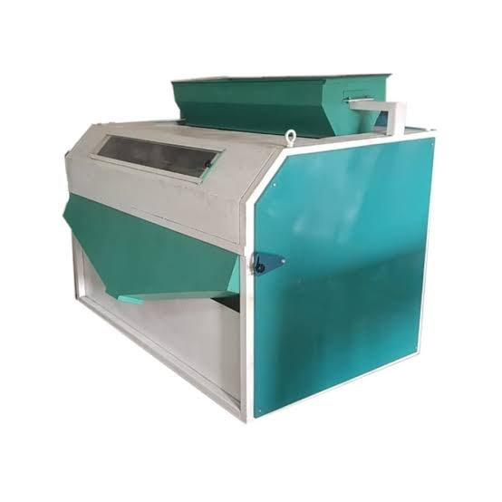
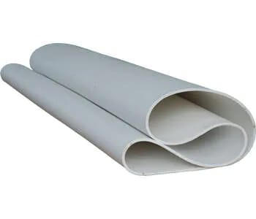
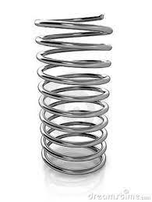
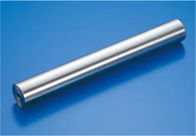
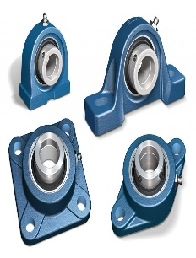
PRODUCT DETAIL :-3.
MAGNET DESTONER MACHINE
MAGNET DESTONER MACHINE IS USEFUL FOR REMOVE MUDBALLS , BLACKSTONES & OTHER PARAMAGNETIC IMPURTIES FROM GRAINS
MAGNET DESTONER REMOVE THOSE STONE IN WHICH MAGNETIC PARTICLES ARE AVAILABLE
MAGNET DESTONER MACHINE PARTS ARE MAGNET DESTONER M.S BODY , ROUND MAGNET BAR , MAGNET DESTONER RUBBER BELT , MAGNET DESTONER MOTOR , MAGNET DESTONER BEARING
RUBBER BELT
SPRING
GEAR & MOTOR
MAGNET BAR
BEARING

Slide 8
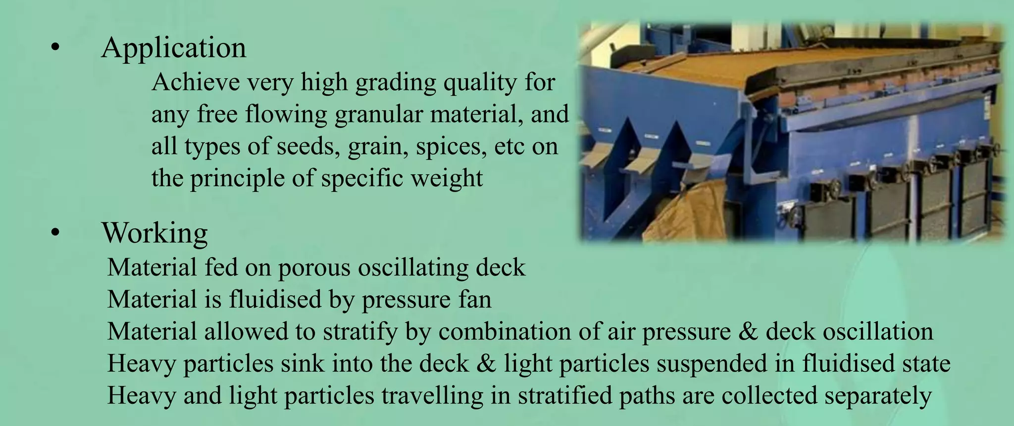
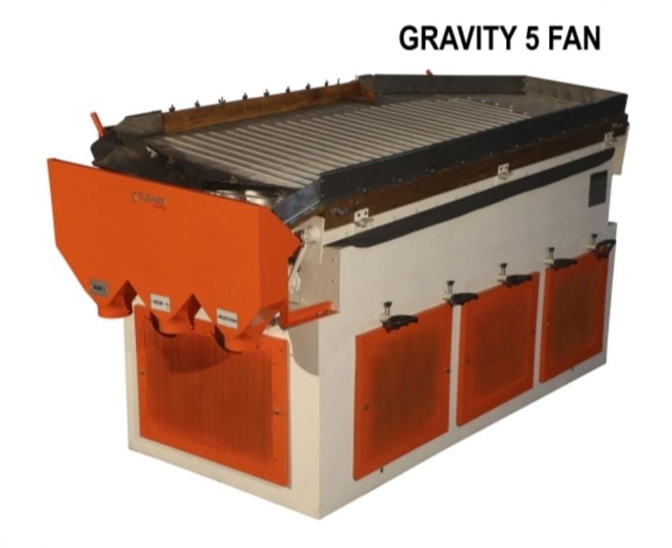
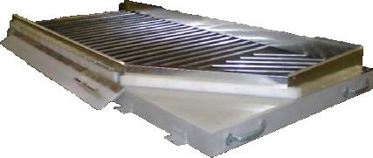

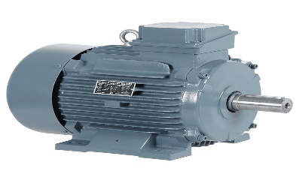

PRODUCT DETAIL :-4.
GRAVITY SEPERATOR MACHINE
GRAVITY DECK
V-BELT PULLEY
FOOT MOUNTING
MOTOR
V-BELT
BEARING

Slide 9
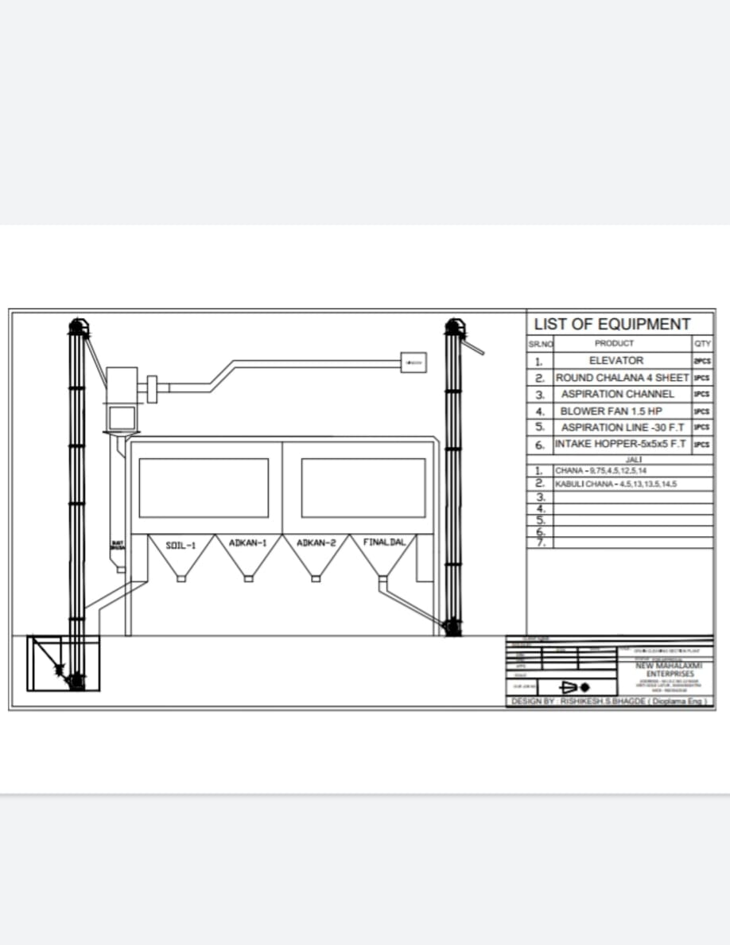
MULTIPURPOSE GRAIN CLEANING PLANT LAYOUT

Slide 10
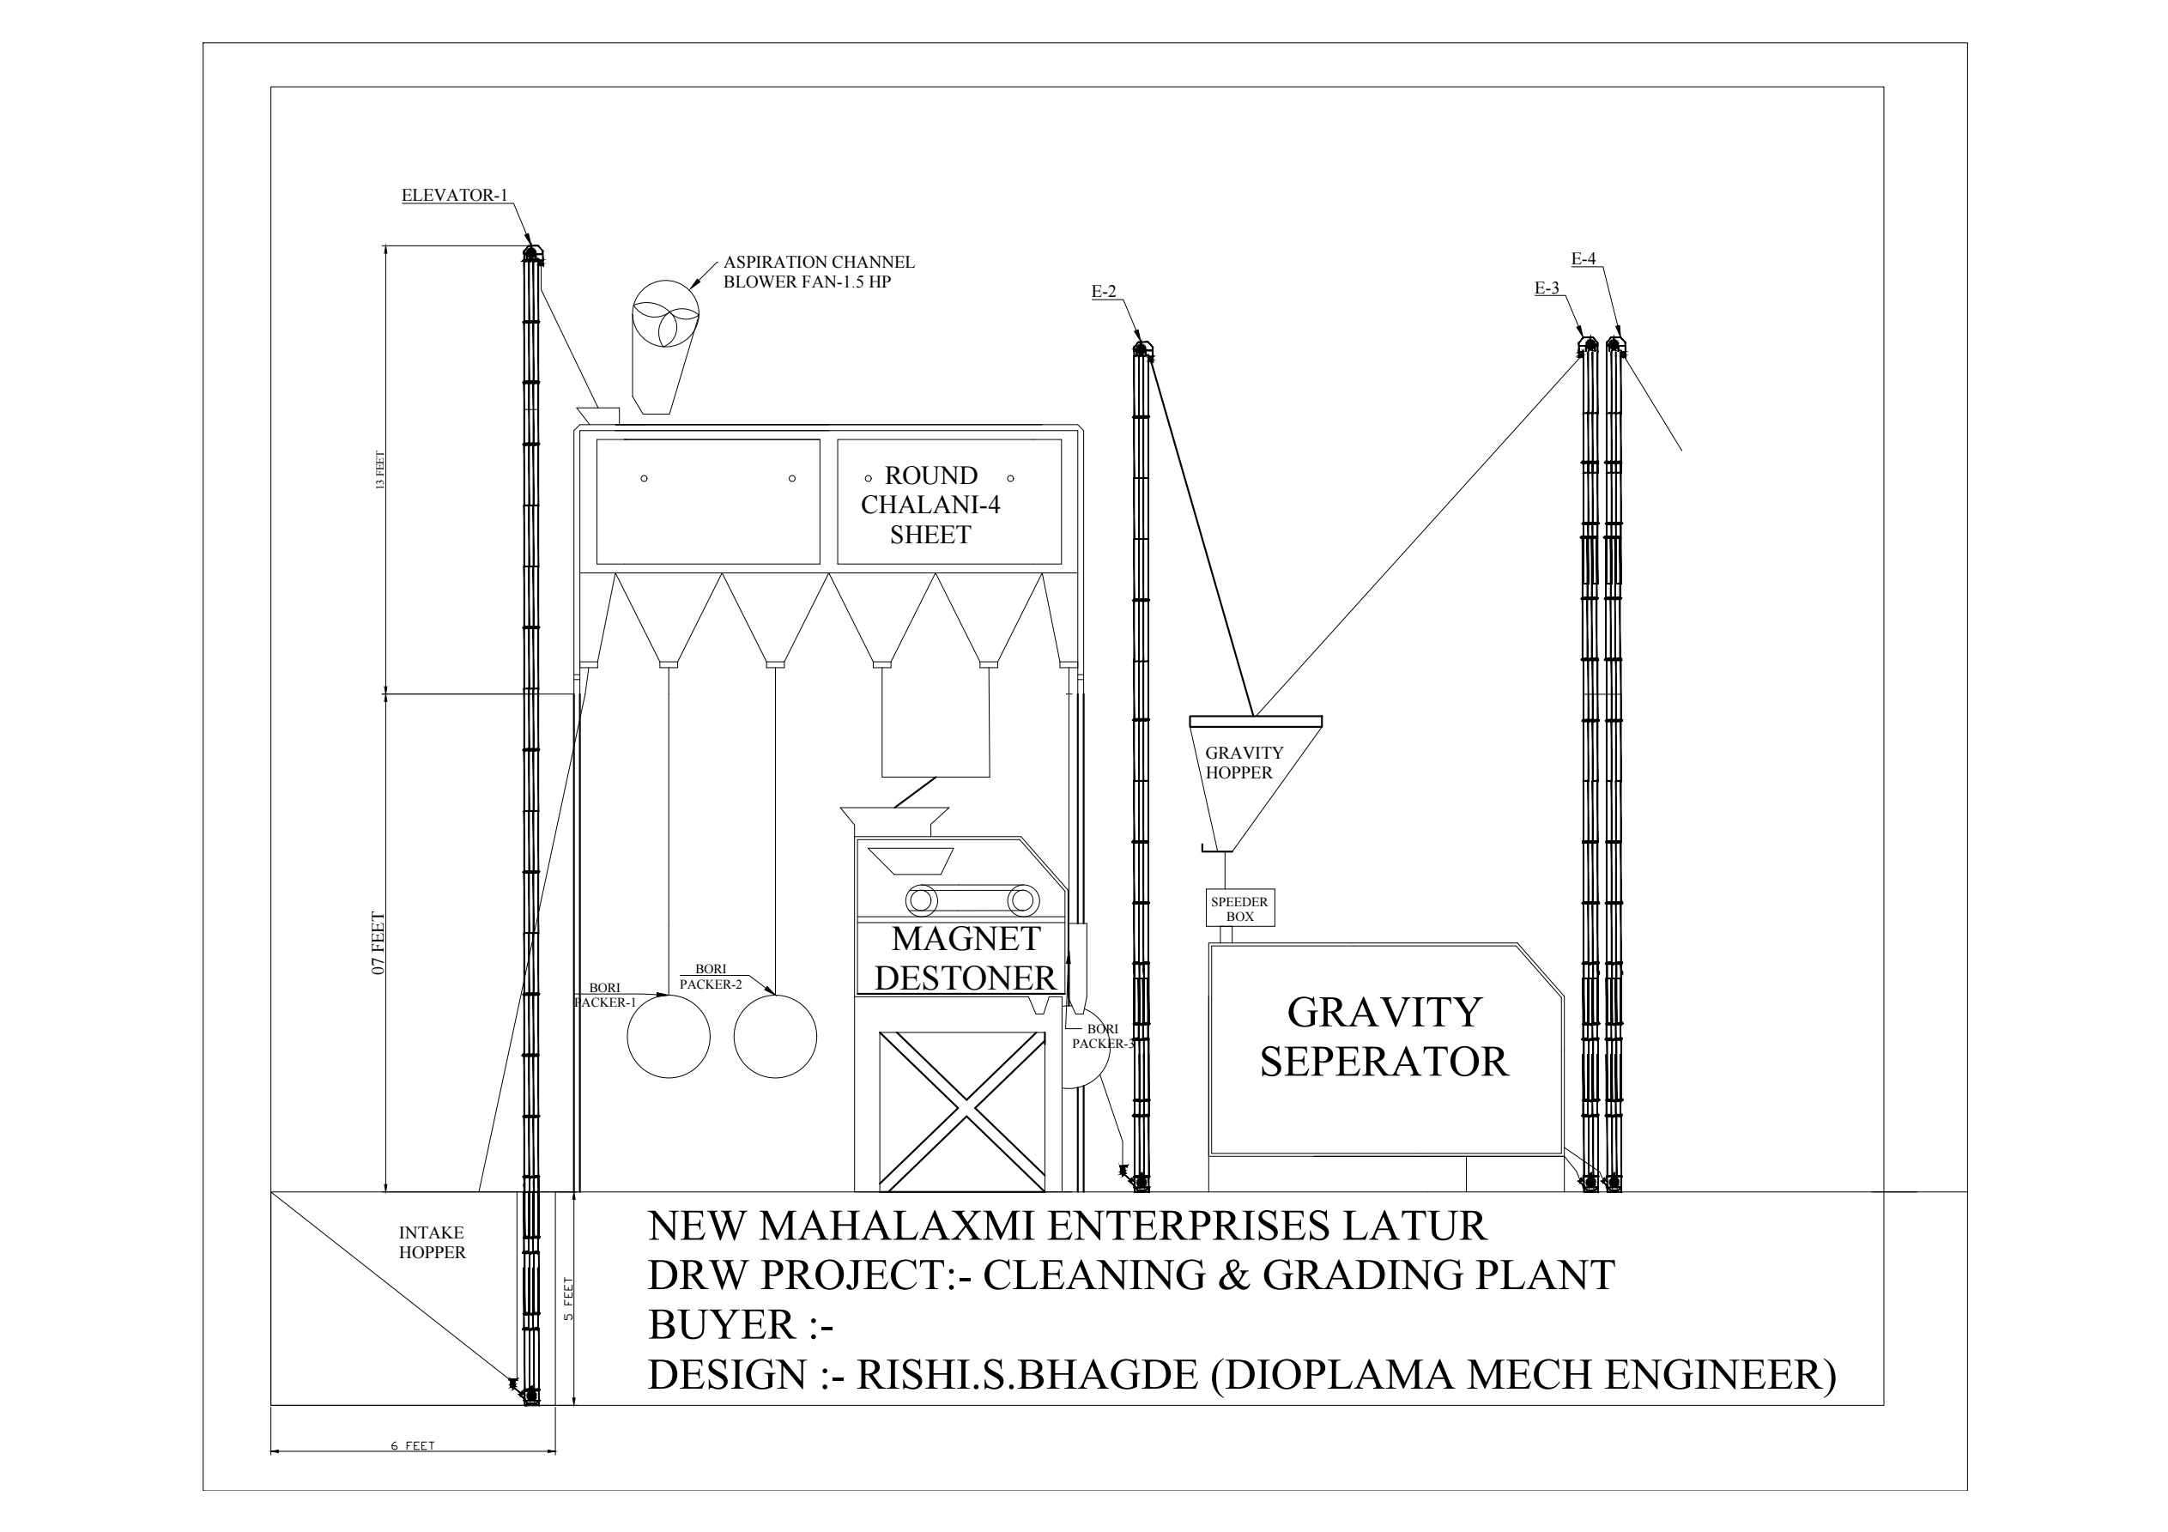
MULTIPURPOSE GRAIN CLEANING & GRADING PLANT LAYOUT

Slide 11
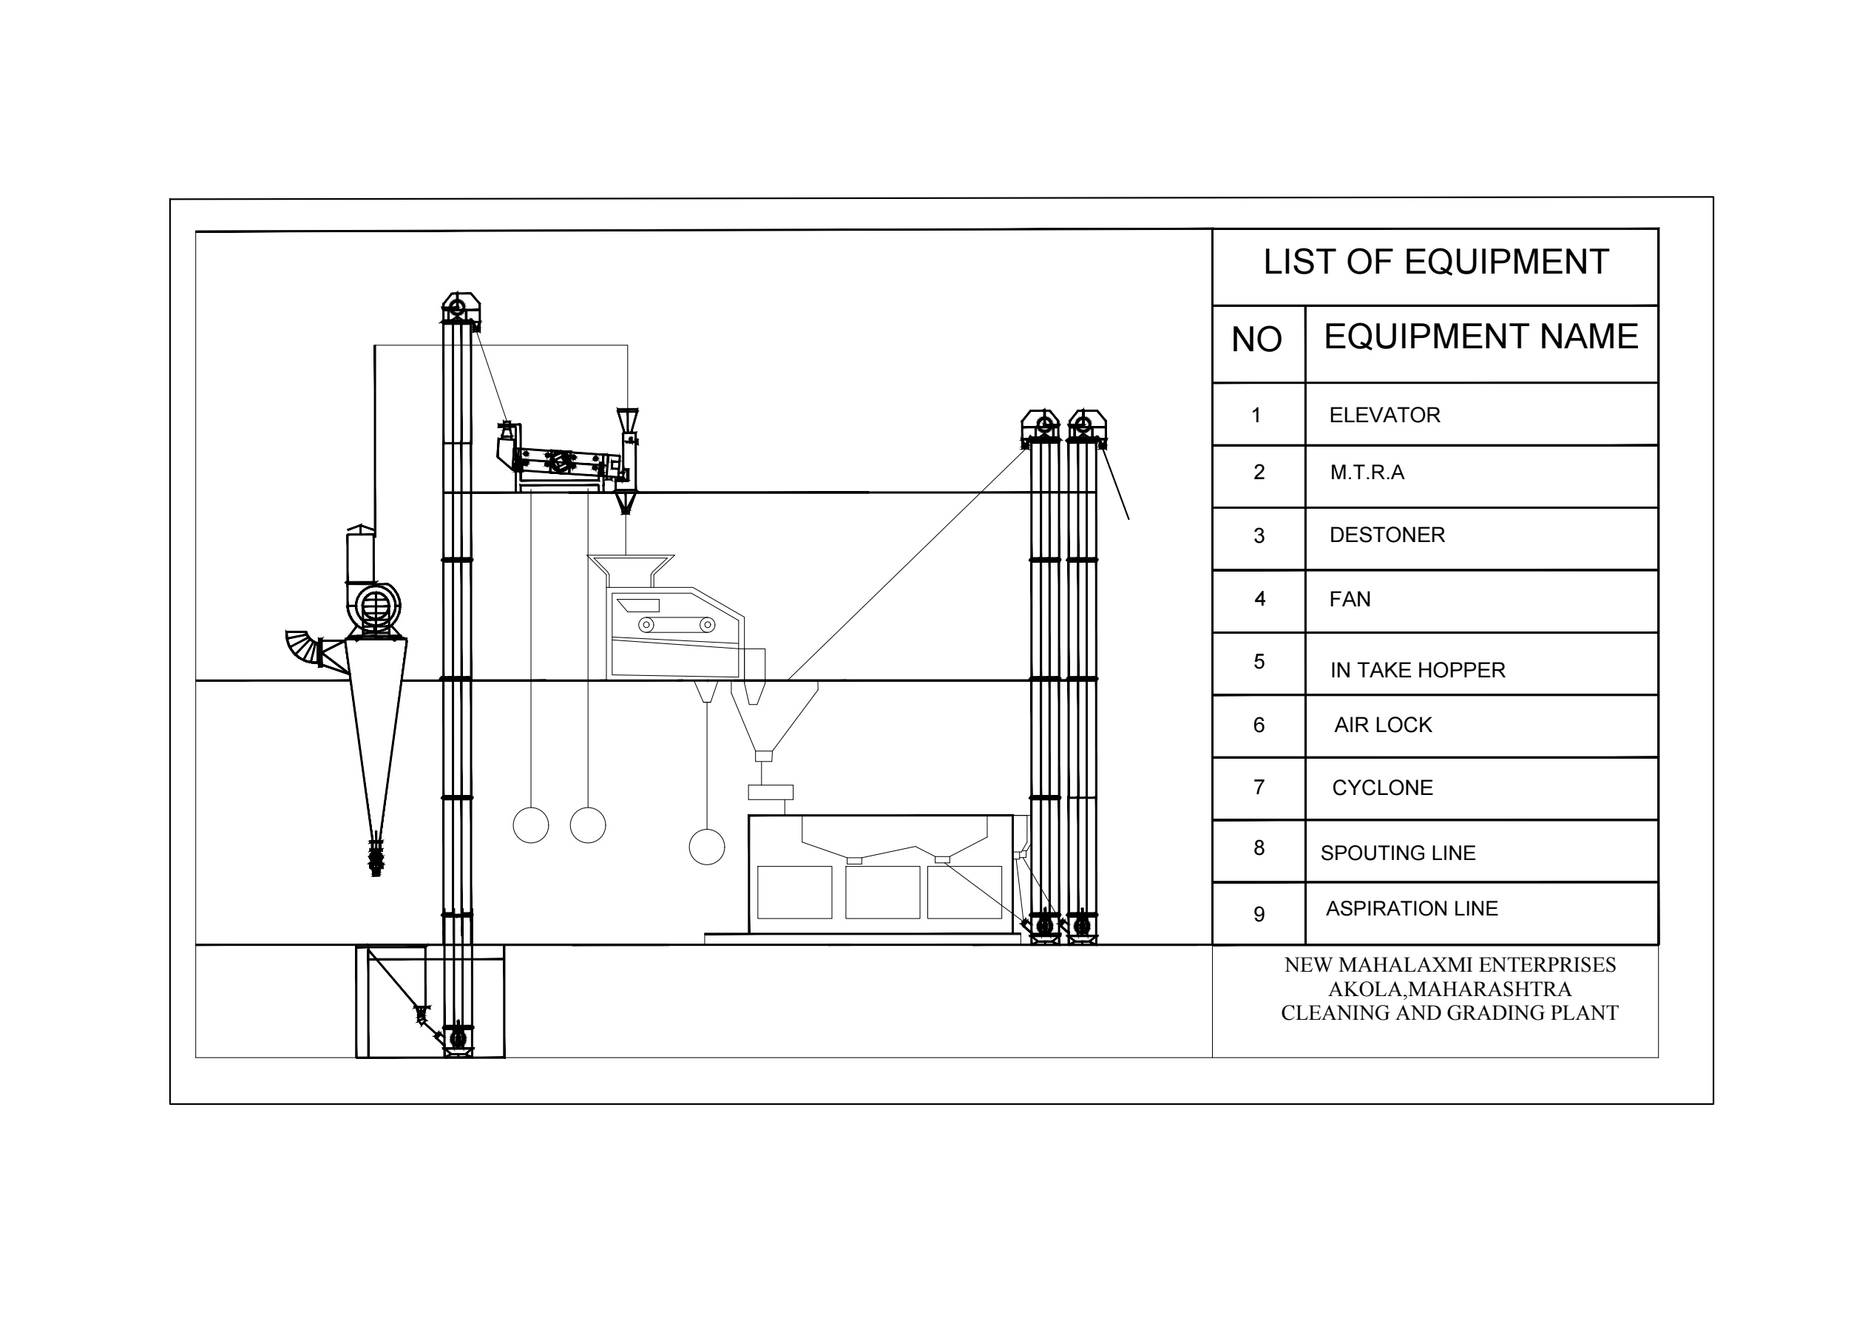
MULTIPURPOSE GRAIN CLEANING & GRADING PLANT LAYOUT

Slide 12
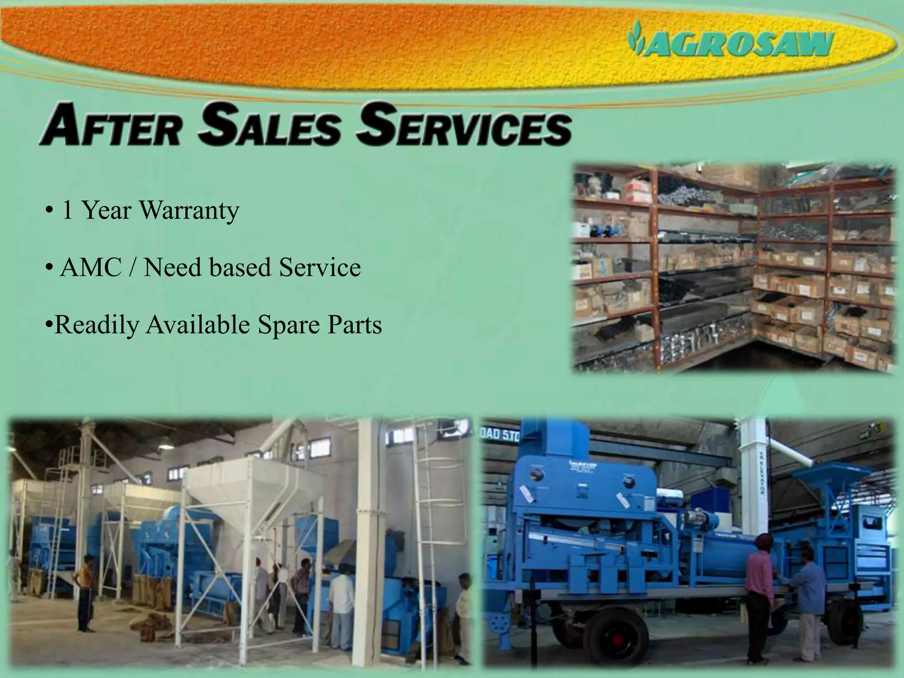

Slide 13
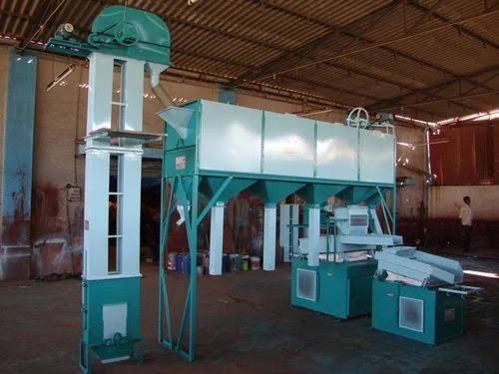

Slide 14
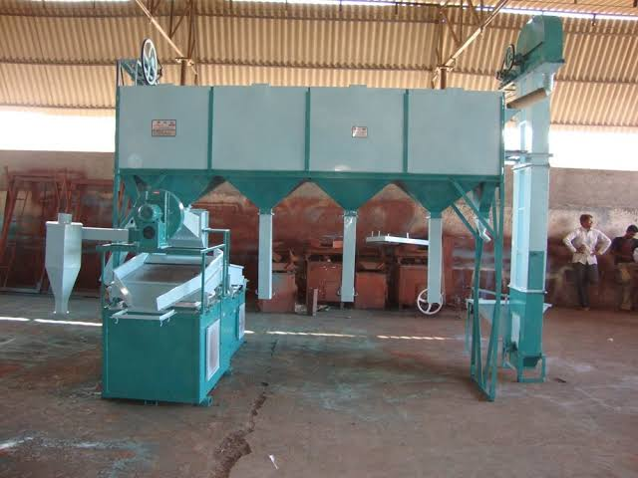

Slide 15
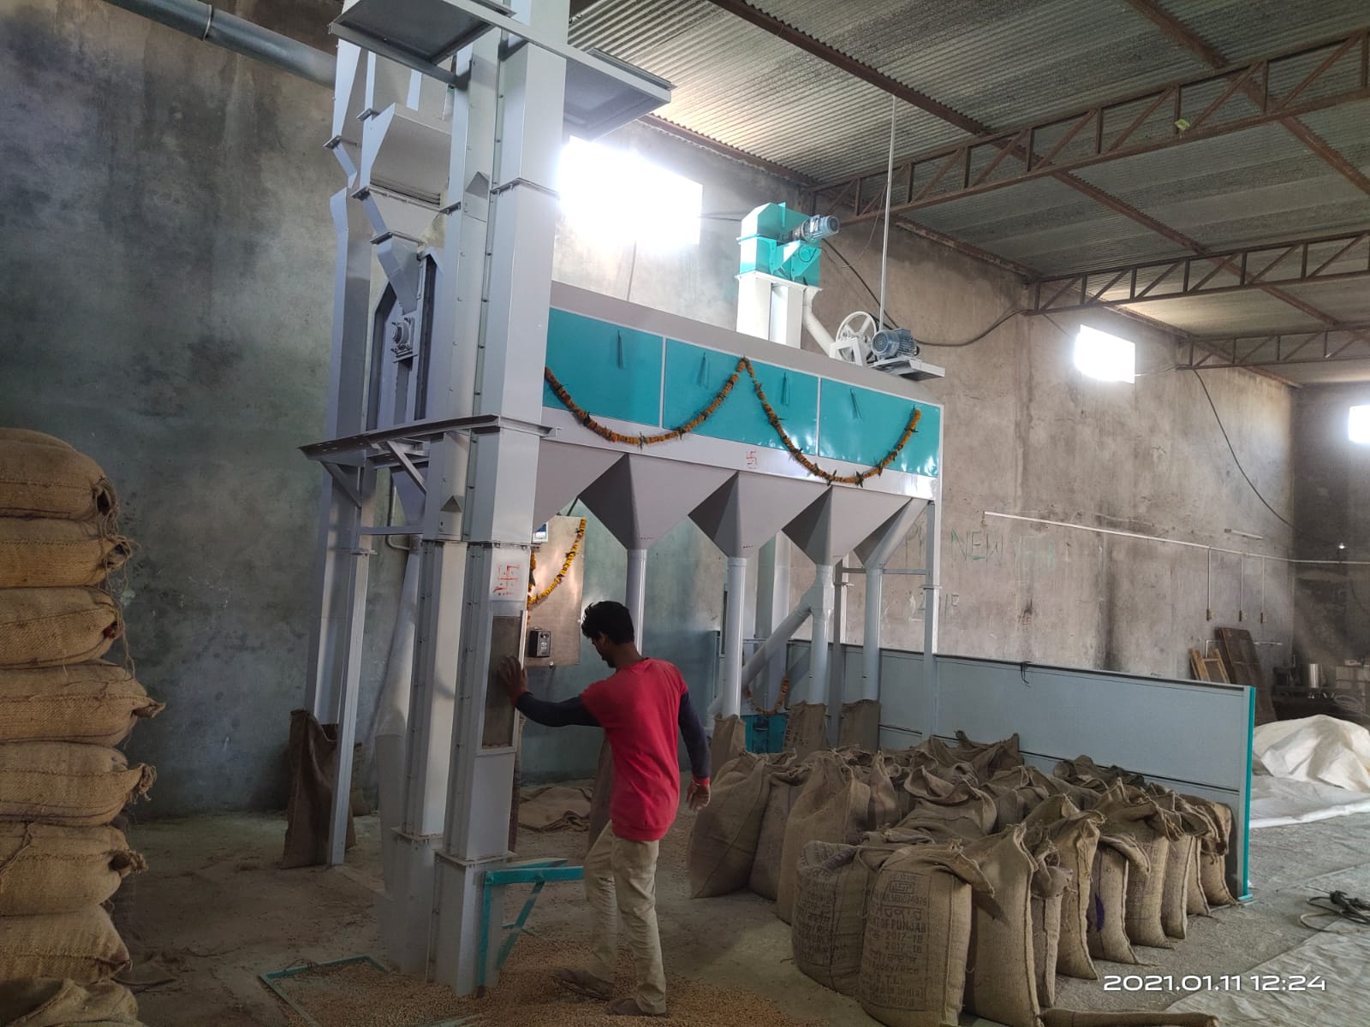
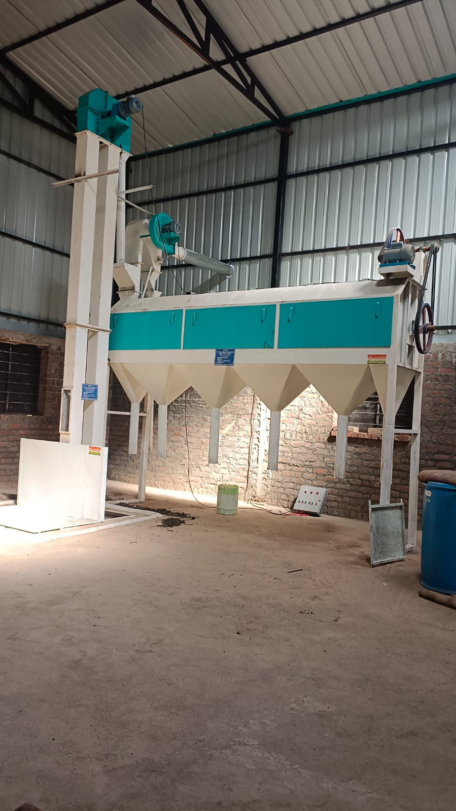
MULTIPURPOSE GRAIN CLEANING PLANT 1.5 TO 2.5 TPH
KADADI TRADER , LATUR , MAHARASHTRA

Slide 16
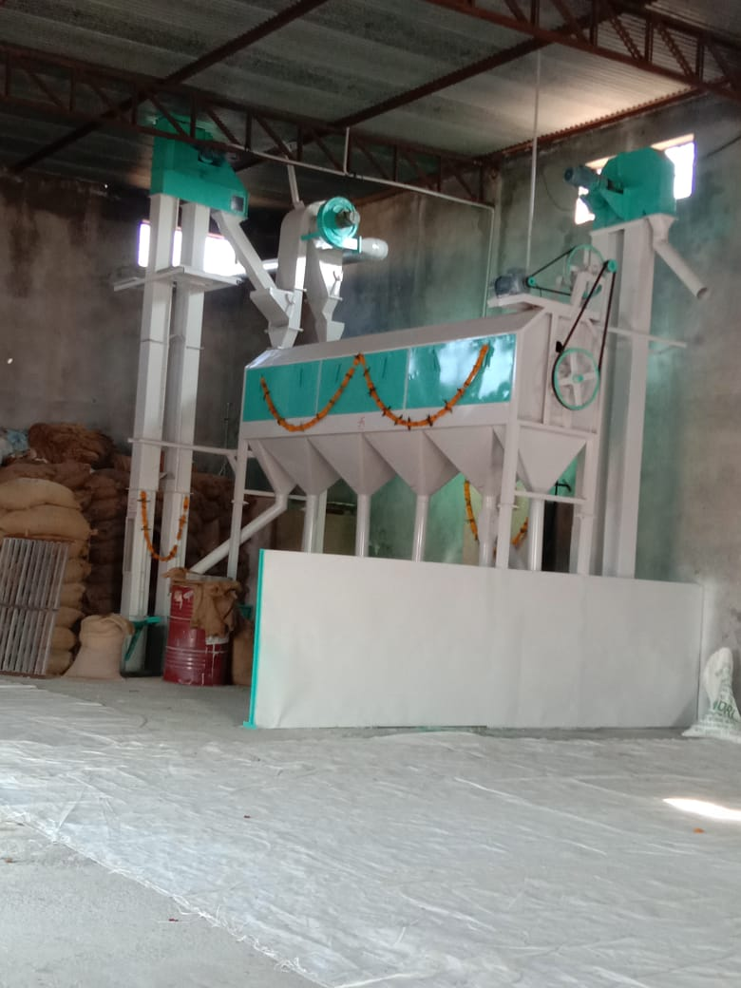
MULTIPURPOSE GRAIN CLEANING PLANT 1.5 TO 2.5 TPH
KADADI TRADER , LATUR , MAHARASHTRA

Slide 17
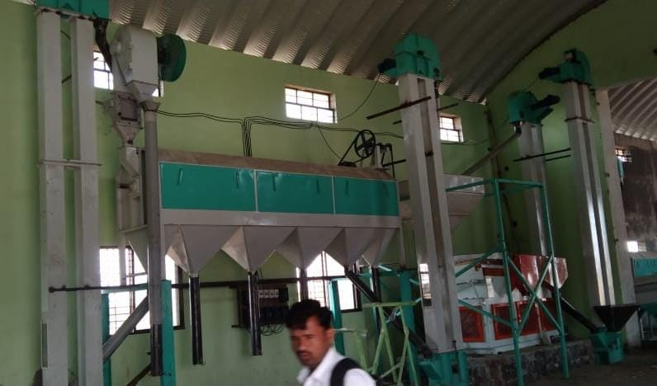
MULTIPURPOSE GRAIN CLEANING & GRADINGPLANT 2 TO 2.5 TPH.
DEEP FPO , AMBEJOGAI , MAHARSHTRA

Slide 18
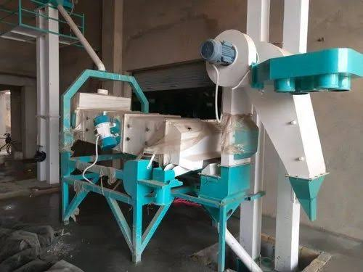
MULTIPURPOSE GRAIN CLEANING PLANT 2 TON PER HOUR.
SATISH IND , LATUR , MAHARASHTRA

Slide 19
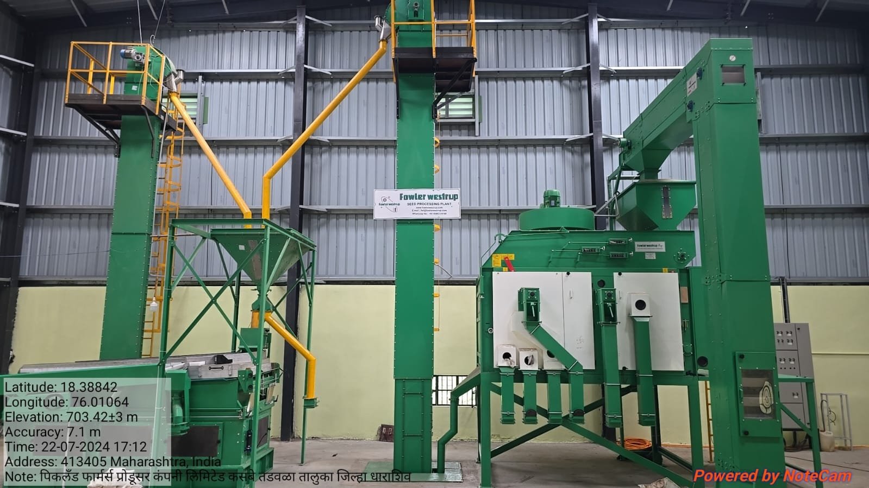

Slide 20
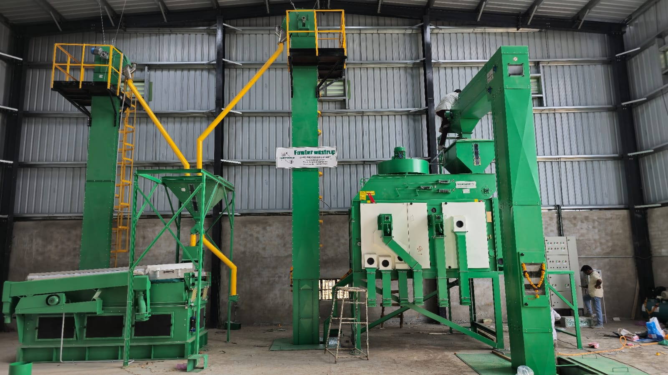

Slide 21
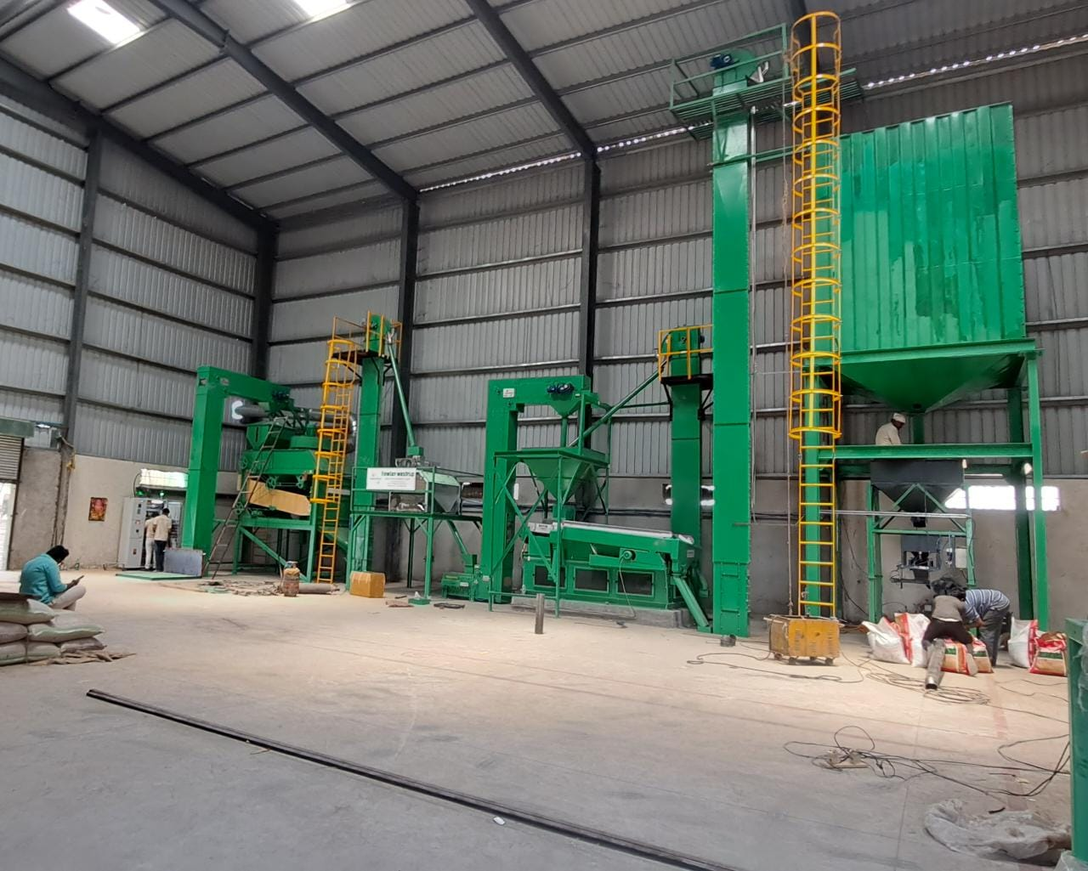
MULTIPURPOSE GRAIN CLEANING & GRADING PLANT & PACKAGING PLANT-4TPH
GRREN LIMITED LATUR , MAHARAHTRA

Slide 22
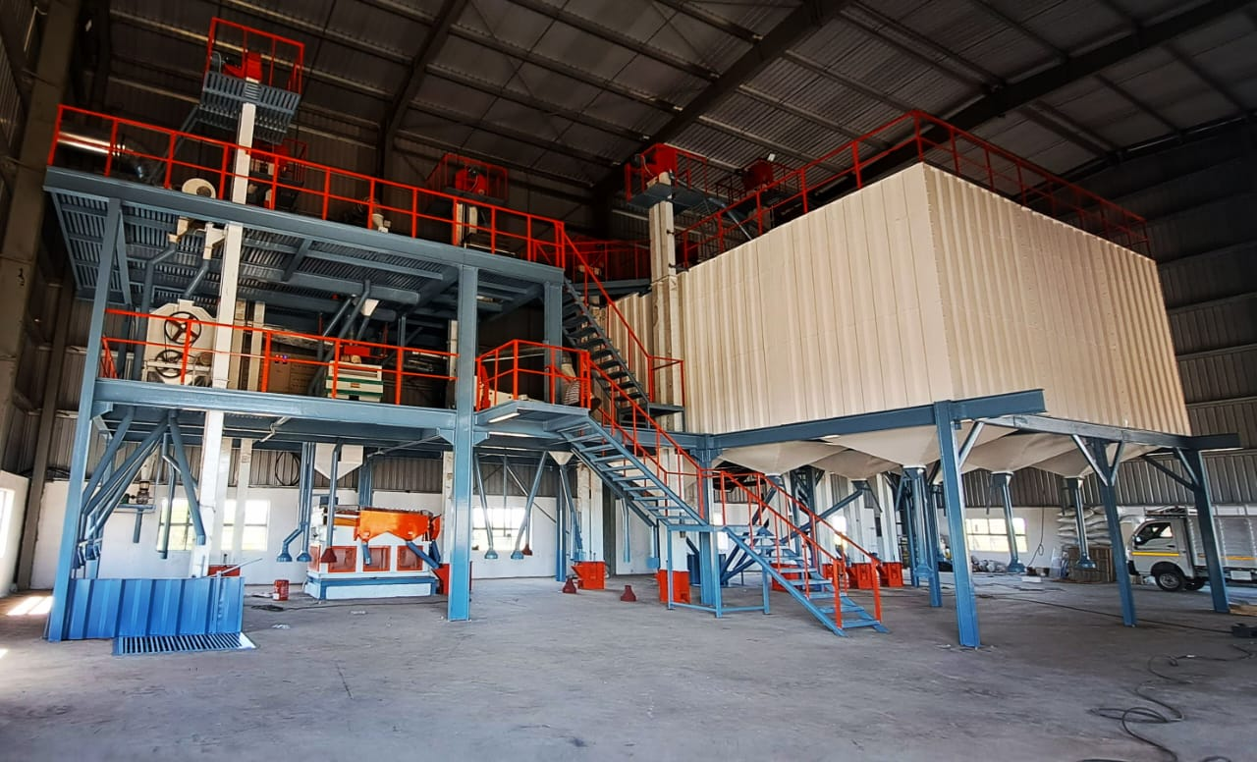
MULTIPURPOSE GRAIN CLEANING ,GRADING & SORTING PLANT-4 TPH
NATURAL FPO RANJANI , LATUR , MAHARASHTRA

Slide 23
THANK YOU

